Slide 1
Operation Analytics and Investigating Metric Spike

Slide 2
Project Description
Analytics is the analysis done for the complete end to end operations of a organization. with the help of this, the company then finds the areas on which it must improve upon. this kind of analysis is further used to predict the overall growth.

Slide 3
Project Approach
First I create database by using dataset files which was
provided by the company.
Than next step load the data(table) into MYSQL Workbench.
Perform the task or execute the quary.

Slide 4
Tech-Stack Used
MySQL Workbench provides data modelling, SQL development, and various administration tools for configuration. It also offers a graphical interface to work with the databases in a structured way.
Microsoft power point 2010: It is used to make a report (PPT) to be presented to the leadership team.
Internet connection.

Slide 5
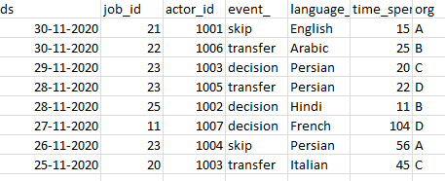
Insights
Case study 1
using job_data table

Slide 6

Calculate the number of jobs reviewed per hour per day for November 2020?
select count(distinct job_id)/(30*24) as num_jobs_reviewed from job_data where ds between '2020-11-01' and '2020-11-30';

Slide 7
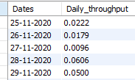
Calculate 7 day rolling average of throughput? For throughput, do you prefer daily metric or 7-day rolling and why?
select ds as Dates, count(event_)/sum(time_spent) as Daily_throughput from job_data group by ds order by ds;

Slide 8
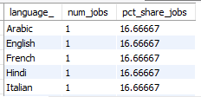
Calculate the percentage share of each language in the last 30 days?
select language_, num_jobs,100.0* num_jobs/total_jobs as pct_share_jobs from(select language_, count(distinct job_id) as num_jobsfrom job_datagroup by language_)a cross join(select count(distinct job_id) as total_jobs from job_data)b;

Slide 9

Let’s say you see some duplicate rows in the data. How will you display duplicates from the table?
SELECT actor_id, COUNT(actor_id) as Duplicate_id FROM job_data GROUP BY actor_id HAVING COUNT(actor_id) > 1

Slide 10
Case study 2
Using bellow table
users,
events,
email_events.

Slide 11

Calculate the weekly user engagement?
select extract(week from occurred_at) as "week num",count(distinct user_id) as "weekly active user" from events where event_type="engagement" group by 1;

Slide 12

Calculate the user growth for product?
select months,users,((users/lag(Users) over (order by Months)-1)*100) as "growth in percent“ from(select extract(MONTH from created_at) as Months,count(activated_at) as Usersfrom users where activated_at not in ("")group by 1order by 1)a;

Slide 13
Calculate the weekly retention of users-sign up cohort?
select count(user_id), sum(case when retention_week = 1 then 1 else 0 end) as per_week_retention from(select a.user_id, a.sign_up_week, b.engagement_week, b.engagement_week - a.sign_up_week as retention_weekfrom((select distinct user_id, extract(week from occurred_at) as sign_up_weekfrom eventswhere event_type = 'signup_flow'and event_name = 'complete_signup'and extract(week from occurred_at)=18)aleft join(select distinct user_id, extract(week from occurred_at) as engagement_weekfrom eventswhere event_type = 'engagement')bon a.user_id = b.user_id)group by user_idorder by user_id;

Slide 14
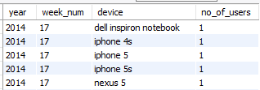
Calculate the weekly engagement per device?
Select extract(year from occurred_at) as year,extract(week from occurred_at) as week_num,device,count(distinct user_id) as no_of_users from events where event_type = 'engagement'group by 1,2,3 order by 1,2,3;

Slide 15

Calculate the email engagement metrics?
select100.0 * sum(case when email_cat = 'email_opened' then 1 else 0 end) /sum(case when email_cat = 'email_sent' then 1 else 0 end)as email_opening_rate,100.0 * sum(case when email_cat = 'email_clicked' then 1 else 0 end) /sum(case when email_cat = 'email_sent' then 1 else 0 end) as email_clicking_ratefrom(select *,case when action in ('sent_weekly_digest', 'sent_reengagement_email') then 'email_sent' when action in ('email_open') then 'email_opened' when action in ('email_clickthrough') then 'email_clicked'end as email_catfrom email_events)a;

Slide 16
Result
In this project, I learned how to apply advanced SQL concepts like Windows Functions, etc. I understood how the real-world industry works.
It helped me in improve my SQL concepts.
The challenge here is that the data in case study 2 is very huge for that I load the data but the main thing I learn a lot, how to work on large dataset.

Slide 17
Thank you

